Slide 1
SIFT
Computer Vision
Umberto Castellani

Slide 2

Convolution

Slide 3
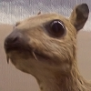
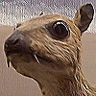
Image convolution
Sharpening filter

Slide 4
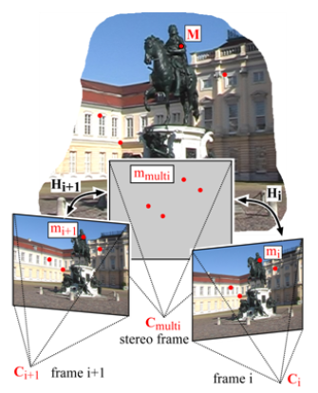
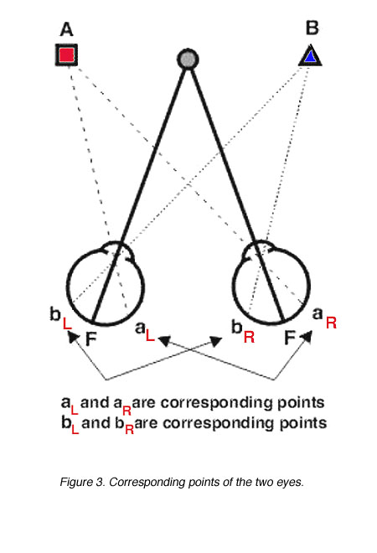
Corresponding point computation
Convolution is crucial to build image filters for the estimation of corresponding points

Slide 5
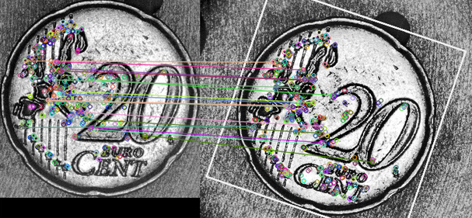
Corresponding point computation
The idea consists to identify a limited set of salient points (or feature point) to be used for matching purposes.
Three phases:
Salient point detection,
Salient point description,
Salient point matching.

Slide 6
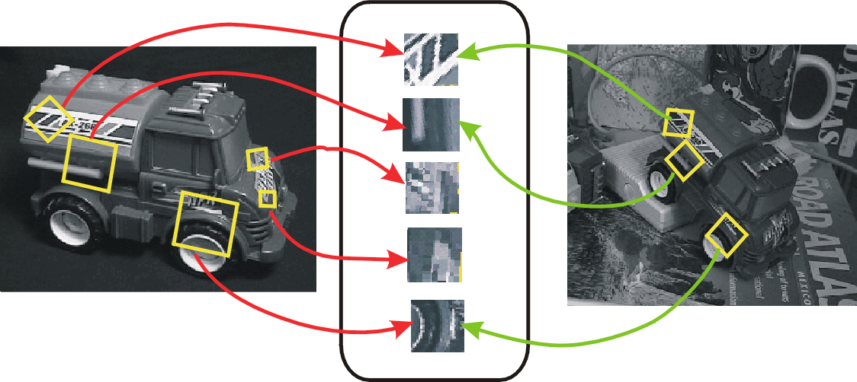
Scale Invariant Feature Transform
The method Scale Invariant Feature Transform (SIFT) detects salient points (i.e., points with hight contrast) using a Laplacian of Gaussian (LoG) filter to the Scale Space :

Slide 7
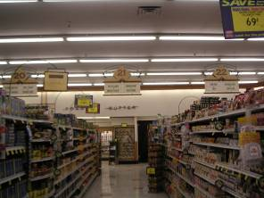
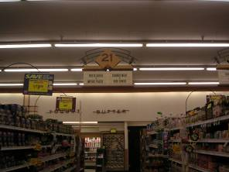
Scale Invariant Feature Transform
The metod must be invariant to:
Scale,
Rotation,
Illumination,
Point of view (affine).

Slide 8
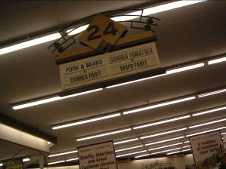
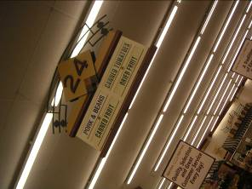
Scale Invariant Feature Transform
The metod must be invariant to:
Scale,
Rotation,
Illumination,
Point of view (affine).

Slide 9
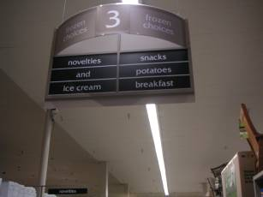
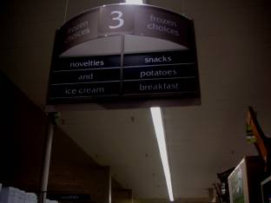
Scale Invariant Feature Transform
The metod must be invariant to:
Scale,
Rotation,
Illumination,
Point of view (affine).

Slide 10


Scale Invariant Feature Transform
The metod must be invariant to:
Scale,
Rotation,
Illumination,
Point of view (affine).

Slide 11
Scale Invariant Feature Transform
Obiective: identify location and scale of stable points or regions. Two ideas: Scale space and Image Pyramid
The Scale Space of an image is a function L(x,y,σ) that is obtained by a convolution of a Gaussian kernel (at different scales) with the input image:

Slide 12
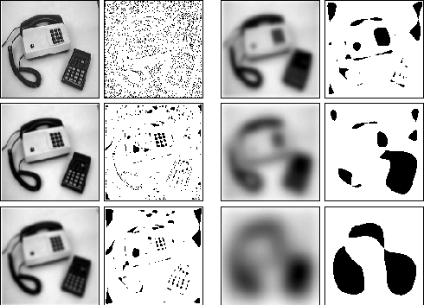
Scale Space
Notes:
Notare che nella scena ci sono strutture con scale intrinseche diverse (es: la cornetta del telefono, la tastiera, i singoli tasti, etc.). Dunque un’oggetto può apparire in maniera diversa a seconda della scala in cui è osservato. Per questo si adotta un’approccio multiscala.

Slide 13
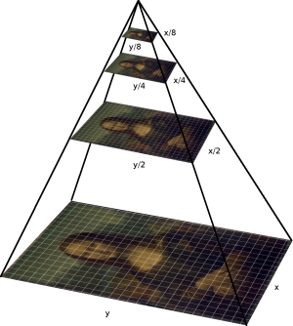
Scale Invariant Feature Transform
Obiective: identify location and scale of stable points or regions. Two ideas: Scale space e Image Pyramid
Image Pyramid: it is a set of resampled images at different descendent levels (octave) :

Slide 14
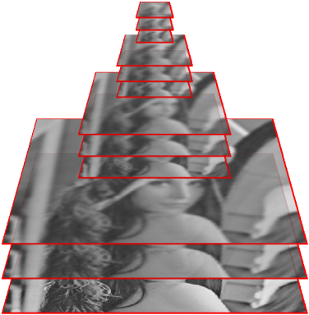
Scale Space+ Pyramids

Slide 15
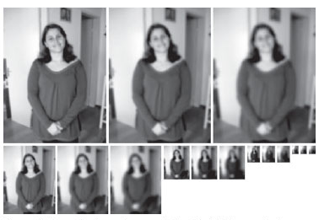
Scale Space+ Pyramids

Slide 16
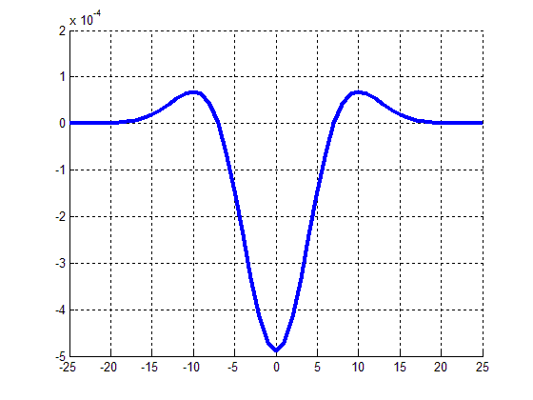
Scale Invariant Feature Transform
The Difference of Gaussian filter is used to approximate the Laplacian of Gaussian filter:
Salent points (blob) are extremants (min or max) for both space and scale (a 3x3x3 window is used on the scale space) !
Notes:
I punti salienti (blob) sono quelli estremanti (massimi o minimi) locali del laplaciano! Poi i laplaciano per l’associatività della convoluzione con la gaussiana diventa laplaciano di Gaussiane, che viene approssimato da differenze di gaussiane!
Si dimostra che in questo modo il punto saliente trovato è invariante alla scala! Inoltre il laplaciano è invariante alla rotazione per cui si ottiene la detection invariante alla rotazione!
SIFT rende più efficiente il metodo di Lindemberg creando lo spazio scala con dei ‘gradoni’ costituiti dal ricampionamento dell’immagine (ottava).

Slide 17
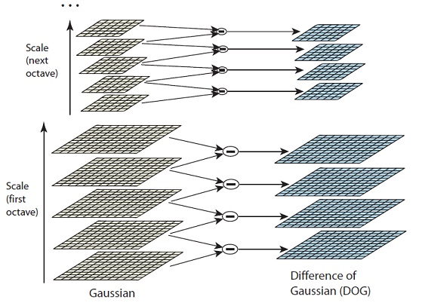
Scale Invariant Feature Transform
Maxima and minima in a
3*3*3 neighborhood

Slide 18
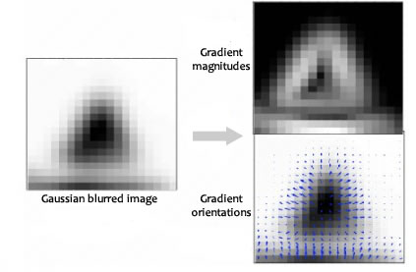
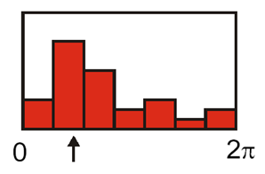
Scale Invariant Feature Transform
Orientaton: it is estimated from the histogram of gradients on a local region of 16x16 pixels on the Gaussian pyramid level (scale) where the salient point has been detected.

Slide 19
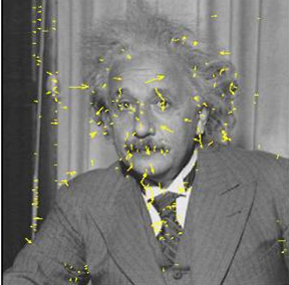
Scale Invariant Feature Transform
SIFT point detection: arrows represent orientation and lenght.

Slide 20
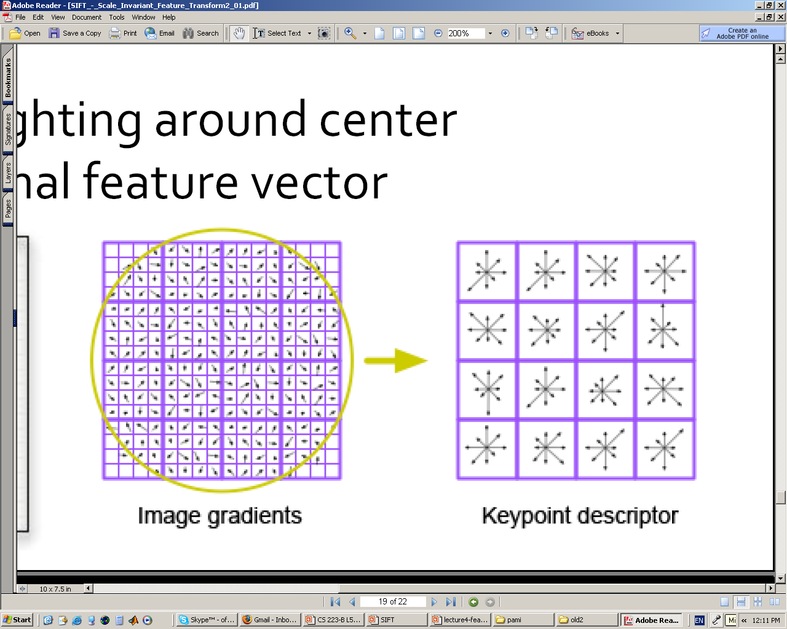
Scale Invariant Feature Transform
Point Descriptor:
The point descriptor is a 128-vector obtained from the concatenation of the 16 histograms (8 bin each)!

Slide 21
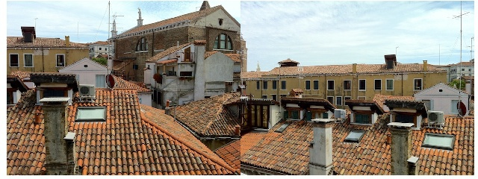
Scale Invariant Feature Transform
The point matching is obtained from the comparison of descriptors

Slide 22
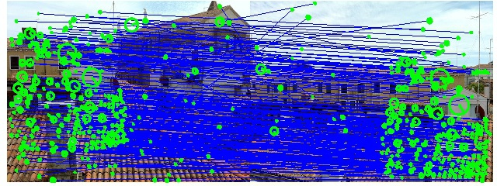
Scale Invariant Feature Transform
The point matching is obtained from the comparison of descriptors

Slide 23
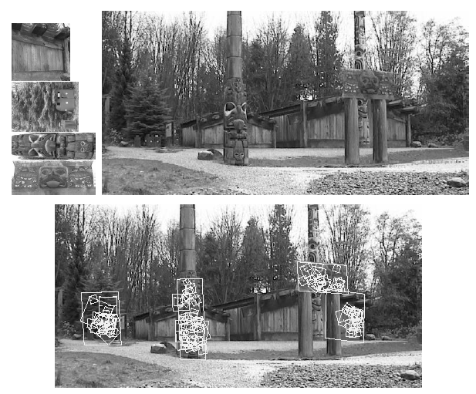
Scale Invariant Feature Transform

Slide 24

Scale Invariant Feature Transform
Matlab Intermezzo:
http://www.vlfeat.org/overview/sift.html#tut.sift.match

